Slide 1
Fundamental Principles of Airmanship
LO4 – Know processes used to launch gliders and maintain flight

Slide 2
Objectives
Describe processes used to launch gliders.
P8

Slide 3
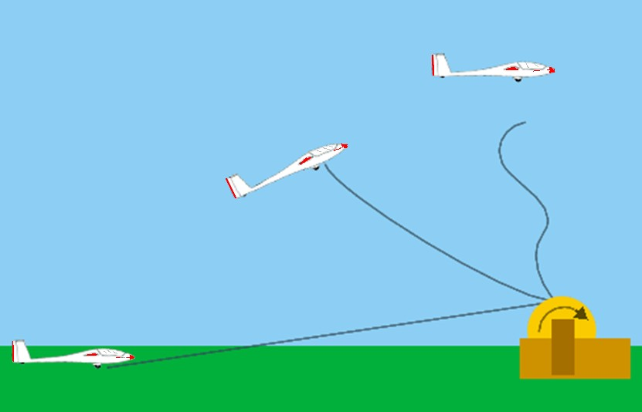
Launching a Glider
P8
“All clear above and behind”
“Take up slack” [1 finger]
“All out” [2 fingers]
Notes:
There are 3 stages to launching a winch-launched glider (Viking), these are;
“All clear above and behind”
When the glider is completely ready and it is safe to launch, the pilot and wing tip holder check above and behind the glider to ensure there are no hazards.
“Take up slack” [1 finger]
The pilot indicates with one finger and gives the command “Take up slack”.
The signaller passes this on to the winch driver using lamp signals or large bats. The winch driver pulls slack out of the cable.
“All out” [2 fingers]
When the pilot is satisfied that the slack has all been taken up, the order “All out” is given.
The signaller passes this on to the winch driver using lamp signals or large bats. The winch speeds up and the glider begins ground ride and launch with the wing tip holder holding the wings level to begin with.

Slide 4
Any Questions

Slide 5
Objectives
Describe processes used to launch gliders.
P8

Slide 6
Fundamental Principles of Airmanship
LO4 – Know processes used to launch gliders and maintain flight

