Slide 1
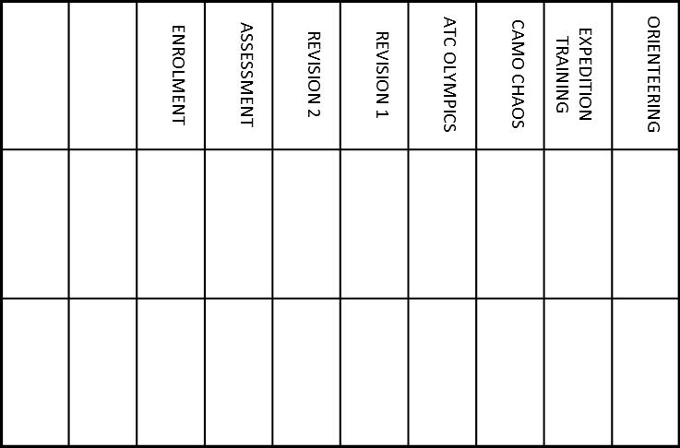
LOUD AND CLEAR | FLYING HIGH | MARCHING FEET 2 | MARCHING FEET 1 | SPIT ‘N POLISH | RAF BRIEFING | WHO ARE WE? | ACTIVITY
 |  |  |  |  |  |  | DATE
 |  |  |  |  |  |  | STAFF SIGNATURE
Over the next 8 weeks you will participating in a number of exciting activities. Make sure you bring this book with you to all parade nights so that you can get the activities signed off.
XXXX (ANYTOWN) SQUDRON ATC JUNIOR CADET RECORD OF SERVICE
NAME:
D.O.B:
CONTACT NUMBER:
SQUADRON CONTACT INFORMATION
Address Line 1
Address Line 2
Town
POSTCODE
Telephone Number
(Will be answered on Mondays and Thursdays between 1845 and 2130, outside of these hours please leave a message or email the Squadron)
XXXX@aircadets.org
Website

