Slide 1
WHO ARE WE?
1871 Junior Cadet Training Programme

Slide 2
Scope
Aims of the Air Training Corps
Structure of the Air Training Corps
1871 Squadron Staff
Ranks and Classifications
Basic Discipline
Quiz

Slide 3
The Aims of the Air Training Corps
To promote and encourage among young men and women a practical interest in aviation and the Royal Air Force
To provide training which will be useful both in the Services and in civil life
To foster the spirit of adventure
To develop the qualities of leadership and good citizenship
ATC Moto = Venture Adventure

Slide 4
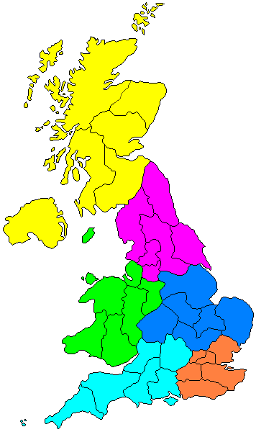
The Structure of the Air Training Corps
National = Air Training Corps
Regional = Wales and West Region
County = Staffordshire Wing
Town = 1871 (Rugeley) Squadron
Us!

Slide 5
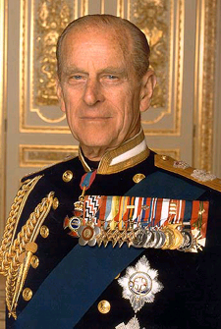
The Structure of the Air Training Corps
Air Commodore- In- Chief
Marshal of the Royal Air Force, His Royal Highness, Duke of Edinburgh, Prince Philip

Slide 6
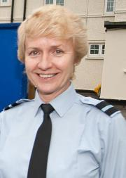
The Structure of the Air Training Corps
Commandant Air Cadets
Air Commodore McCafferty
HQ Air Cadets
RAF College Cranwell
(Lincolnshire)

Slide 7
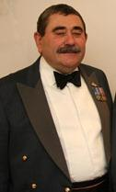
The Structure of the Air Training Corps
Regional Commandant
Group Captain Allen
HQ Wales and West Region
RAF Cosford

Slide 8
The Structure of the Air Training Corps
Wing Commander
Wing Commander Sharrad- Williams
HQ Staffordshire Wing
RAF Cosford

Slide 9
1871 Squadron Staff
We have a team of Officers, Non- commissioned Officers and Civilian Instructors:
-
-
-
-
-
-
-

Slide 10
ATC Structure Summary
Corps
Region
Wing
Squadron
Air Commodore- In- Chief
Air Commodore
Regional Commandant
Wing Commander
Squadron Commander

Slide 11
ATC Structure Summary For Us…
Corps
Wales and West Region
Staffordshire Wing
1871 (Rugeley) Squadron
The Duke of Edinburgh
Air Commodore McCafferty
Group Captain Allen
Wing Commander Sharrad-Williams
Officer Cadet Grocott

Slide 12
Uniformed Staff Ranks
Officers
NCOs
Pilot Officer
Adult Sergeant
Flying Officer
Adult Flight Sergeant
Flight Lieutenant
Squadron Leader
Adult Warrant Officer
Wing Commander

Slide 13
Cadet Ranks (NCOs)
Corporal
Sergeant
Flight Sergeant
Cadet Warrant Officer

Slide 14
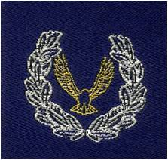
Cadet Classifications
First Class Cadet
Leading Cadet
Senior Cadet
Master Cadet
Instructor Cadet

Slide 15
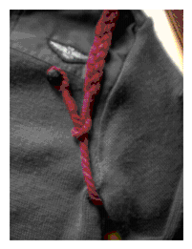
Other Badges!
Band
Navigation
Shooting
Communicator
Leadership Course
Gliding
Flying
Duke of Edinburgh Award
Junior Leaders

Slide 16
Basic Discipline
“10 Golden Rules”
Address female members of staff as “Ma’am” and male members of staff as “Sir”
Address NCOs by their rank (e.g. Corporal or Sergeant)
Stand to attention when talking to ANY member of staff or visitor.
Knock on the office door and classroom doors before entering
Be respectful of your peers (bullying is not tolerated)
Always be polite (i.e no swearing and no eating in classrooms)
Do not be late
Make sure you look smart (i.e. polished shoes, frequent hair cuts and shaves for males; hair tied back in a bun and no ladders in tights for females)
If you say you are going to do something, then do it!
Be proud of your Squadron.

Slide 17
Quiz!
1. What is our Squadron number?
1871
2. Who is the OC?
Officer Cadet Grocott
3. Which Wing is Rugeley Squadron in?
Staffordshire Wing
4. Who is the Wing Commander?
Wing Commander Sharrad-Williams
5. Where is our Wing HQ?
RAF Cosford
6. Which Region is Rugeley Squadron in?
Wales and West Region

Slide 18
Quiz!
7. Where is HQAC?
RAF College Cranwell
8. Who is the Air Commodore?
Air Commodore McCafferty
9. Who is the Air Commodore- In- Chief?
HRH, The Duke of Edinburgh, Prince Philip
10. How do you address a female member of Staff?
Come to attention and call her “Ma’am”
11. How do you address a male member of Staff?
Come to attention and call him “Sir”

Slide 19
Quiz!
12. What is this NCO rank called?
Corporal
13. What is this NCO rank called?
Sergeant
14. What classification do you need to complete to get this badge?
First Class
15. What is this Officer rank called?
Flight Lieutenant

Slide 20
Who is who in the ATC exercise

Slide 21
Who is who in the ATC exercise
Air Commodore- In- Chief
=
HRH, The Duke of Edinburgh, Prince Philip
Air Commodore
=
Air Commodore
McCafferty
HQAC =
RAF College
Cranwell
Region =
Wales & West
Region
Regional Commandant
=
Group Captain
Allen
Based at
RAF
Cosford
Wing =
Staffordshire
Wing
Wing Commander
=
Wing Commander
Sharrad-Williams
Based at
RAF
Cosford
1871
(Rugeley)
Squadron
Squadron Commander
=
Officer Cadet
Grocott

