Slide 1
The Royal Air Force
LO2 - Understand why security is important

Slide 2
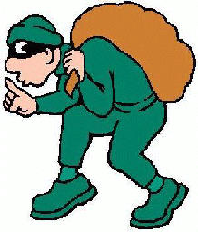
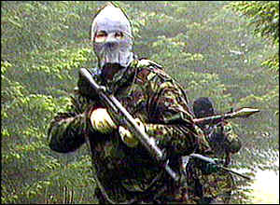
Squadron Security
Every Cadet must play their part in looking after the Squadrons buildings and equipment.
Threats:
Theft and Vandalism
Terrorism
If you see a suspicious person, ask them to identify themselves, and escort them to a member of staff.

Slide 3
Suspicious Objects
Do not disturb the object
Raise the alarm by ringing the Fire Alarm
Report what you have found to a member of Staff,
who will call the Police
4. Evacuate the building and retire to a safe distance

Slide 4
Information Security
Documents marked “For official use only” are okay, but their contents should not be discussed outside of the Squadron
If you see anything marked “Restricted” or “Confidential”,
You should report them immediately to a member of staff,
as they should be kept locked away

Slide 5
Visits to RAF Stations
Every Cadet must play their part in the security
of the Station they are visiting.
You will normally receive a Security Briefing which will detail:
Where you can and cannot take photographs
Restricted Areas
Known threats and risks

Slide 6
Need to Know?
The best security rule to remember is the
“Need to Know” principle
Before passing on any information to anyone, or
answering any questions, THINK…
DOES THAT PERSON NEED TO KNOW?

Slide 7
The Royal Air Force
LO2 - Understand why security is important

