Slide 1
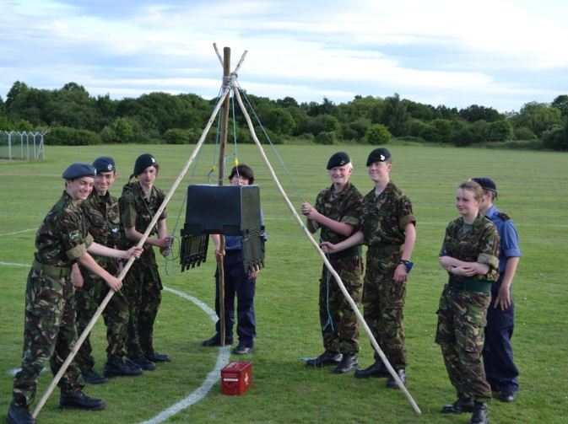
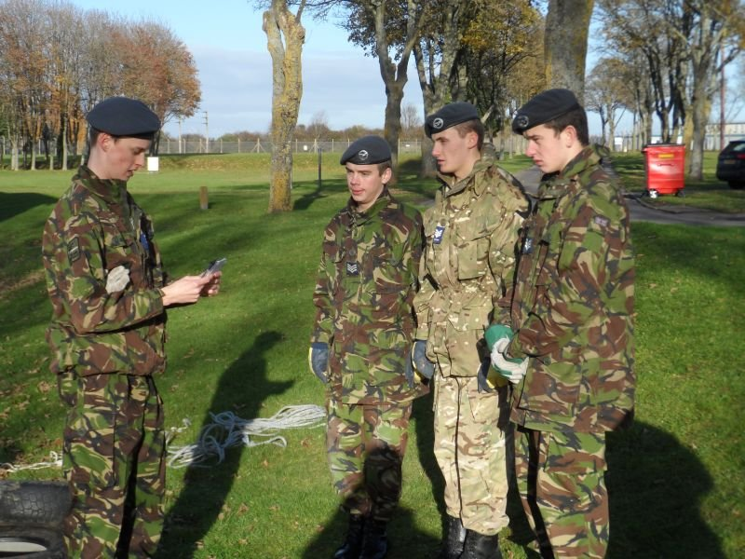

Foundation Leadership: Blue Badge
The SMEAC Brief

Slide 2
Aims
By the end of this lesson you will be able to:
State what each of the letters in the acronym “SMEAC” represent.
Explain what each part of the acronym means in simple terms.
Produce and deliver a SMEAC brief to enable a group to complete a task.

Slide 3
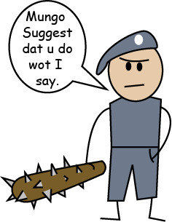
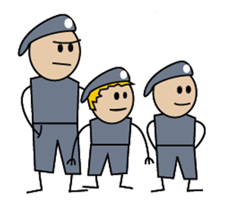
What makes a Good Leader?
Ahhhh, I guess he is in charge!
Notes:
In cadets you will often get opportunities to lead, especially as you get more experienced. We are looking to give you the tools that you need to be able to take this opportunity on and lead cadets effectively.

Slide 4
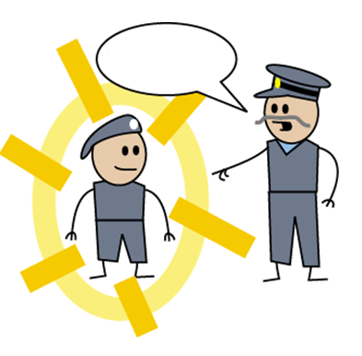
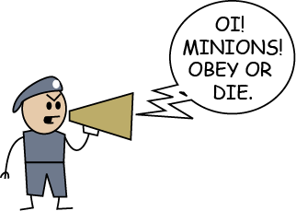
What makes a Good Leader?
Congratulations
you are now a corporal…. with great power comes great responsibility!
At the end of Monday’s parade night…
…parade night Thursday!
Notes:
Ask Cadets to make suggestions about what makes a good leader (or if they struggle what makes a bad leader). If time allows they could write on post it notes and points could be discussed.

Slide 5
Why does the Air Cadets need good leaders?
To direct groups
To perform tasks
Administration
To be a good leader you will always need to brief your team before you start anything else…
Notes:
Administration – this refers to the use of groups to enable messages and information to be passed on effectively to those that need it. Splitting large groups into smaller more manageable groups.

Slide 6
What is SMEAC?
SMEAC is an acronym
Acronyms are widely used within the military and cadets for example AWOL, HQAC and ACP.
SMEAC will help you remember how to brief your team effectively
Huh?

Slide 7
Situation
S
Situation gives a quick overview of what’s going on
We are….There is….
Situation should only be one or two sentences long

Slide 8
Mission
SM
Mission gives an outline of what you as a team have to do
The mission is to… in order to…
Short, snappy statements
Repeat twice for clarity

Slide 9
Execution
SME
The most important part of the briefing
Outline the task in more detail including any equipment or resources available
Inform the team of any limitations or safety instructions
Ask for ideas to formulate the best plan

Slide 10
Any Questions?
SMEA
Your team can ask you questions to clarify the brief.
No question is a stupid question
Every question should be answered by going over the relevant part of the brief in more detail
Answer questions with confidence!

Slide 11
Check Understanding
SMEAC
Time to ask your team questions
Ask each member a short question to check understanding
Make sure that each person can answer their question
If a member of the team is unsure rebrief them on that element

Slide 12
Leadership Briefings
You will be read the brief twice.
The first time through just listen to what you are told and look at the exercise area.
The second time you take notes on the brief.
After the second read through ask any questions you have about the exercise, make sure you fully understand.
Once you have your notes it is time to make your SMEAC brief!
Notes:
The cadets will be expected to know how to take the paragraph of briefing information that they are provided with to be able to produce a concise and accurate brief to give to the cadets that they will be leading. They are not to just regurgitate the information that we provide them with verbatim, this is not the aim of the activity.

Slide 13

Example Brief
The Staff Brief
You are a group of troops on a recce and have found a downed enemy aircraft with vital intelligence that needs recovering. The items you recover must be returned to your FOB however, you are now aware of enemy troops also trying to recover the intelligence the only route out and back to your FOB is via a minefield. Your team have 20 minutes to make the way through the minefield, marked out ahead of you avoiding enemy detection by remaining absolutely silent. You may use the mine clearance kit provided. If you or any of the intelligence hits a mine anyone within 2 metres will be killed and all kit will be returned to the start.
Notes:
This is similar to the brief that the leader will receive on the exercises from the staff. FOB = Forward Operation Base.

Slide 14
Example Brief
Situation
You are a group of troops on a recce and have found a downed enemy aircraft with vital intelligence that needs recovering. The items you recover must be returned to your FOB however, you are now aware of enemy troops also trying to recover the intelligence the only route out and back to your FOB is via a minefield. Your team have 20 minutes to make the way through the minefield, marked out ahead of you avoiding enemy detection by remaining absolutely silent. You may use the mine clearance kit provided. If you or any of the intelligence hits a mine anyone within 2 metres will be killed and all kit will be returned to the start.
Notes:
This is similar to the brief that the leader will receive on the exercises from the staff. FOB = Forward Operation Base.

Slide 15
Example Brief
Situation
You are a group of troops on a recce and have found a downed enemy aircraft with vital intelligence that needs recovering. The items you recover must be returned to your FOB however, you are now aware of enemy troops also trying to recover the intelligence the only route out and back to your FOB is via a minefield. Your team have 20 minutes to make the way through the minefield, marked out ahead of you avoiding enemy detection by remaining absolutely silent. You may use the mine clearance kit provided. If you or any of the intelligence hits a mine anyone within 2 metres will be killed and all kit will be returned to the start.
Notes:
Ask the cadets if they could remember what the situation was on the brief on the previous page, if needed reverse the presentation so they can re-read it.

Slide 16
Example Brief
Mission
You are a group of troops on a recce and have found a downed enemy aircraft with vital intelligence that needs recovering. The items you recover must be returned to your FOB however, you are now aware of enemy troops also trying to recover the intelligence the only route out and back to your FOB is via a minefield. Your team have 20 minutes to make the way through the minefield, marked out ahead of you avoiding enemy detection by remaining absolutely silent. You may use the mine clearance kit provided. If you or any of the intelligence hits a mine anyone within 2 metres will be killed and all kit will be returned to the start.
Notes:
This is similar to the brief that the leader will receive on the exercises from the staff. FOB = Forward Operation Base.

Slide 17
Example Brief
Mission
You are a group of troops on a recce and have found a downed enemy aircraft with vital intelligence that needs recovering. The items you recover must be returned to your FOB however, you are now aware of enemy troops also trying to recover the intelligence the only route out and back to your FOB is via a minefield. Your team have 20 minutes to make the way through the minefield, marked out ahead of you avoiding enemy detection by remaining absolutely silent. You may use the mine clearance kit provided. If you or any of the intelligence hits a mine anyone within 2 metres will be killed and all kit will be returned to the start.
Notes:
Can the cadets remember what their mission is? This should be approximately one full sentence again.

Slide 18
Example Brief
Execution
You are a group of troops on a recce and have found a downed enemy aircraft with vital intelligence that needs recovering. The items you recover must be returned to your FOB however, you are now aware of enemy troops also trying to recover the intelligence the only route out and back to your FOB is via a minefield. Your team have 20 minutes to make the way through the minefield, marked out ahead of you avoiding enemy detection by remaining absolutely silent. You may use the mine clearance kit provided. If you or any of the intelligence hits a mine anyone within 2 metres will be killed and all kit will be returned to the start.
Notes:
This is similar to the brief that the leader will receive on the exercises from the staff. FOB = Forward Operation Base.

Slide 19
Example Brief
Execution
You are a group of troops on a recce and have found a downed enemy aircraft with vital intelligence that needs recovering. The items you recover must be returned to your FOB however, you are now aware of enemy troops also trying to recover the intelligence the only route out and back to your FOB is via a minefield. Your team have 20 minutes to make the way through the minefield, marked out ahead of you avoiding enemy detection by remaining absolutely silent. You may use the mine clearance kit provided. If you or any of the intelligence hits a mine anyone within 2 metres will be killed and all kit will be returned to the start.
Notes:
To get high marks cadets must note down all the limitations and be able to convey these clearly to their team. There are a number of these within this exercise. Make sure they always remember to include timing as a limitation.

Slide 20
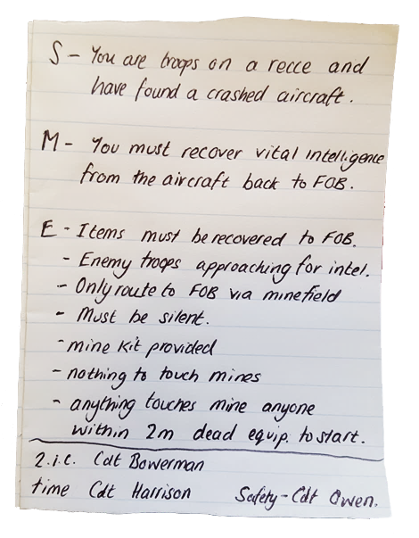
Example Brief
Only write key details on your notepad.
Use bullet points and abbreviations that you understand.
No need for full sentences.
Just write SME part of brief.
Notes:
Only SME are needed to be noted in your note pad. You should automatically do any questions and check understanding. The bottom of this example shows that the I.C. has also allocated three duties to members of the team, 2.I.C., a timekeeper and someone responsible for the safety of the group, in this instance having particular responsibility for checking that nothing comes into contact with a mine.

Slide 21
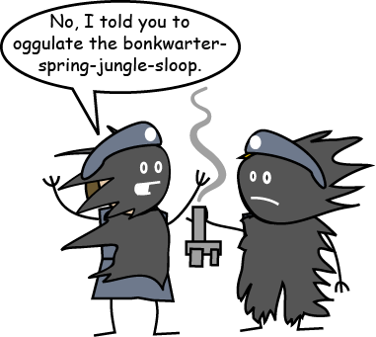
If the task is simple keep the brief simple
Notes:
Do not over complicate the brief with long words or confusing terminology. Ensure that all the group understand any acronyms you use.

Slide 22
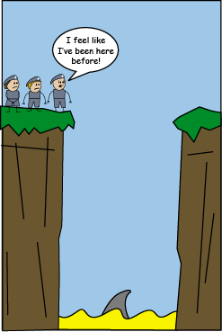
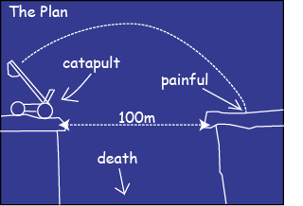
Make an initial plan
Notes:
The initial plan doesn’t have to be too detailed. A rough outline of what you will do immediately and the overview of what you are going to aim to do. Remember plans will often change because of external factors and many plans will develop based on the equipment you may find or because of how the scenario develops.

Slide 23
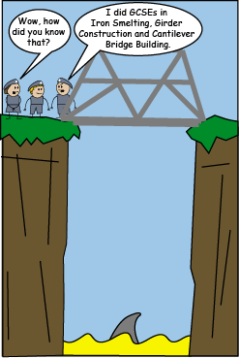
A little planning can go a long way
Notes:
Finding out the skill set of your team can help you develop the most effective plan. You never know what little gem of knowledge you may have in your team.

Slide 24
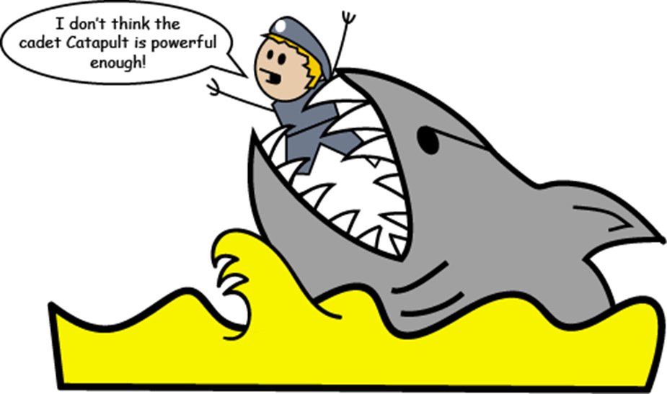
Try to think ahead to the pitfalls
Notes:
What are the likely trouble areas? What are the key dangers etc. How are you going to avoid them? Will appointing a safety/standards person benefit you for your task.

Slide 25
Other Tips
Check that everyone has understood
If things aren’t working out, STOP and explain again.
Make a new plan to solve the problem.
Notes:
Sometimes people will think they have understood what you have asked them to do. Check to be sure and watch carefully, if they look lost and start going away from what you want them to do you need to rebrief them on what you expect.
If problems occur, do not be afraid to say “STOP” gather your team and clarify what you want them to do. You may want to make a new plan before you continue.

Slide 26
Scoring and Passing!
We will be looking at TEN aspects of how you perform as the leader in an exercise.
Each aspect is scored between 1 and 5.
If you score “1” on anything you will need to try again and be re-assessed.
You need to score 30 or more out of 50 on your lead.
Pass TWO exercise leads to qualify for the Blue Leadership Badge.

Slide 27
The 10 elements
Did the team leader follow “SMEAC” as a briefing tool?
Were ALL the limitations mentioned?
Was the time limitation mentioned then monitored?
Was there an initial plan?
Did the team leader re-evaluate if/when things went wrong
Notes:
Make it easy for your assessor to give you marks use the key words of the smeac acronym in your brief, remember the example/

Slide 28
The 10 elements
Did all of the team know what was meant to be happening?
Were limitations monitored?
Was the leader confident?
If you had just entered the room, would you be able to tell who was in charge?
Was praise/encouragement given when necessary?
Notes:
Your assessor will be watching the entire team to see if they are involved and understand what they are doing. We will be looking to see if you are confident and can direct others, if you are the leader do not be afraid to tell people to do something, that is your job!
Praise is importatnt, you don’t need to be a cheerleader but you do need to give praise and encouragement, a team feels valued and will work beter for you if they know you appreciate what they have done.

Slide 29
Team Work
Team Work is essential.
You may be the team leader at some times, at others you will be in the team.
Every team member is important.
If you are not the leader, try not to take over – give the leader a chance to lead.
Notes:
If you have had a particularly successful lead, don’t become cocky and try and take over. Always be a good team member it will help you earn the respect of others when you then have to try and lead them.

Slide 30
Any Questions
?

Slide 31
Aims
By the end of this lesson you will be able to:
State what each of the letters in the acronym “SMEAC” represent.
Explain what each part of the acronym means in simple terms.
Produce and deliver a SMEAC brief to enable a group to complete a task.

